Slide 1
LG BoosT Algorithm

Slide 2
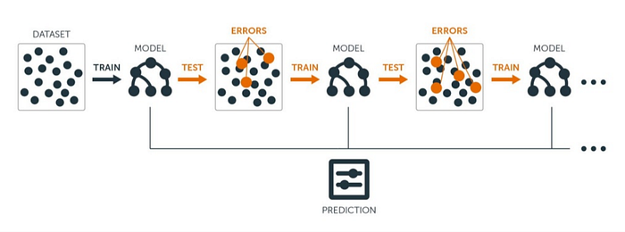

Slide 3
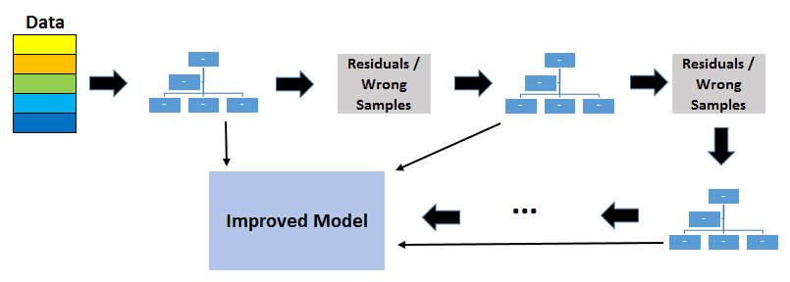

Slide 4
LightGBM is a gradient-boosting framework based on decision trees to increase the efficiency of the model and reduces memory usage.
It uses two novel techniques:
Gradient-based One Side Sampling(GOSS)
Exclusive Feature Bundling (EFB)

